Slide 1
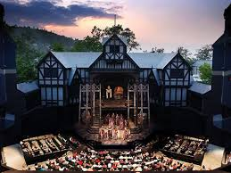
The Elizabethan theatre

Slide 2
Early years
Shakespeare was born on the 26 April 1564. William was an English playwright however was dyslexic and found it hard writing and spelling. Shakespeare was born and brought up in Stratford-upon-Avon. At the age of 18, he married Anne Hathaway, with who he had three children, Susanna, and twins Hamnet and Judith. Between 1585 and 1592, he began a successful career in London as an actor, writer, and part-owner of a playing company called the Lord Chamberlain's Men, later known as the King's Men.

Slide 3
Law for actors
In 1572, a law was passed in Parliament making it compulsory for all actors to have an acting license and a lord as their supporter. As a result of this law, several acting groups were set up. James Burbage started a company called The Chamberlain’s Men (supported by the Lord Chamberlain). Other groups included: the Lord Admiral’s Men, the Queen’s Men, Lord Strange’s Men Acting Troupe and the Earl of Leicester’s Men

Slide 4
Beginning for the theatres
The Elizabethan Theatres started in the cobbled courtyards of Inns, or taverns - they were therefore called Inn-yards. As many as 500 people would attend play performances. There was clearly some considerable profit to be made in theatrical productions. James Burbage was an actor, who at one time would have played in the Inn-yards and , no doubt , negotiated a high price with the Inn keeper to perform on his premises. It was the idea of James Burbage to construct the first of the purpose-built Elizabethan theatres, this is when it got the name theatres.

Slide 5
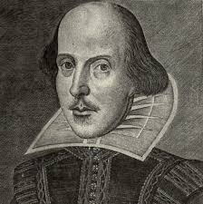
Future years to come
Now many people were paying to see Shakespeare's many famous plays in the theatres and he was now known as one of the most successful play writers in English history.

